Slide 1
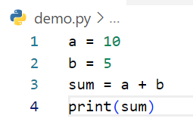
Write step following code below
Step | a | b | sum | output
1 | 10
2 | 10 | 5
3 | 10 | 5 | 15
4 | 10 | 5 | 15 | 15
Example

Slide 2
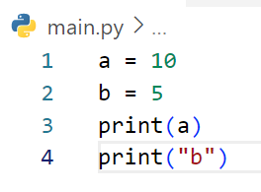
Write step following code below
Step | a | b | output
1 | 10
2 | 10 | 5
3 | 10 | 5 | 10
4 | 10 | 5 | b

Slide 3
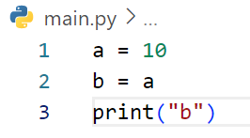
Write step following code below
Step | a | b | output
1 | 10
2 | 10 | 10
3 | 10 | 10 | b

Slide 4
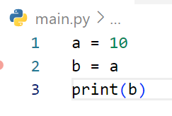
Write step following code below
Step | a | b | output
1 | 10
2 | 10 | 10
3 | 10 | 10 | 10

Slide 5
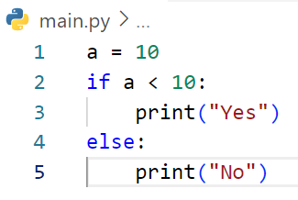
Write step following code below
STEP | a | a<10 | Output
1 | 10
2 | 10 | False
3 | 10 |  | No

Slide 6
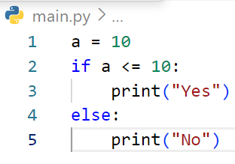
Write step following code below
step | a | a<=10 | output
1 | 10
2 | 10 | True
3 | 10 |  | Yes

Slide 7
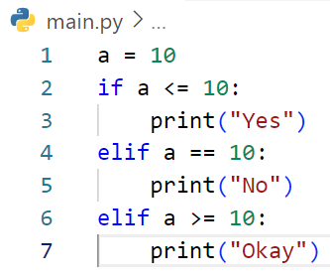
Write step following code below
step | a | a<=10 | a==10 | a>=10 | Output
1 | 10
2 | 10 | True
3 | 10 |  |  |  | Yes

Slide 8
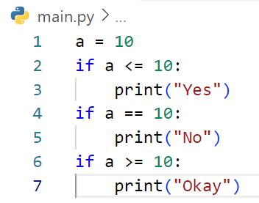
Write step following code below
Step | a | a<=10 | a==10 | a>=10 | output
1 | 10
2 | 10 | True
3 | 10 |  |  |  | Yes
4 | 10 |  | True
5 | 10 |  |  |  | No
6 | 10 |  |  | True
10 | 10 |  |  |  | Okay

Slide 9
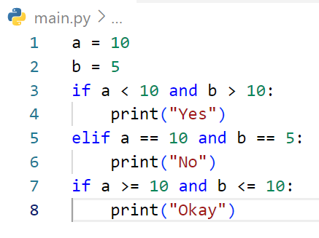
Write step following code below
Step | a | b | a<10 and b>10 | a==10 and b==5 | a>=10 and b<=10 | output
1 | 10
2 | 10 | 5
3 | 10 | 5 | False
4 | 10 | 5 |  | True
5 | 10 | 5 |  |  |  | No
6 | 10 | 5 |  |  | True
7 | 10 | 5 |  |  |  | Okay

Slide 10
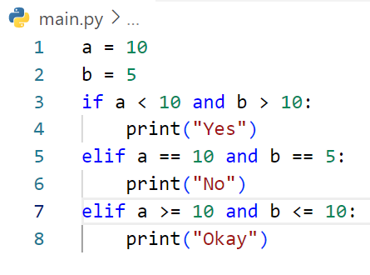
Step | a | b | a<10andb>10 | a==10and b==5 | a>=10 and b<=10 | output
1 | 10
2 | 10 | 5
3 | 10 | 5 | False
4 | 10 | 5 |  | True
5 | 10 | 5 |  |  |  | No
Write step following code below

Slide 11
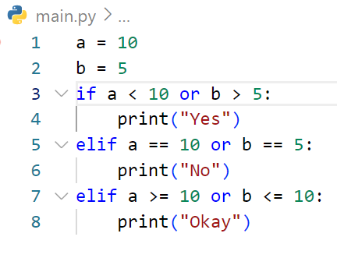
Write step following code below
Step | a | b | a<10 or b>5 | a==10 or b==5 | a>=10 or b<=10 | output
1 | 10
2 | 10 | 5
3 | 10 | 5 | False
4 | 10 | 5 |  | True
5 | 10 | 5 |  |  |  | No

Slide 12
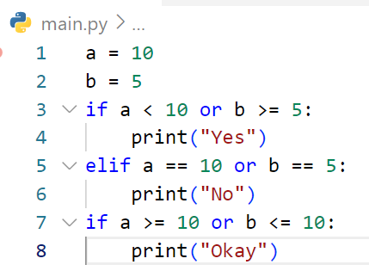
Write step following code below
Step | a | b | a<10 and b>=5 | a==10 or b==5 | a>=10 or b<=10 | output
1 | 10
2 | 10 | 5
3 | 10 | 5 | True
4 | 10 | 5 |  |  |  | Yes
5 | 10 | 5 |  | True
6 | 10 | 5 |  |  |  | No
7 | 10 | 5 |  |  | True
8
10
5
Okay

Slide 13
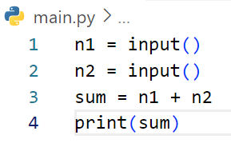
Write step following code below
Step | n1 | n2 | sum | output
1 | 3
2 | 3 | 5
3 | 3 | 5 | 3+5
4 | 3 | 5 | 3+5 | 35
# If user enter first : 3 and second 5

Slide 14
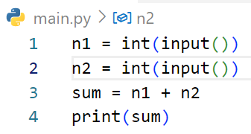
Write step following code below
Step | n1 | n2 | sum | output
1 | 3
2 | 3 | 5
3 | 3 | 5 | 3+5
4 | 3 | 5 | 3+5 | 8
# If user enter first : 3 and second 5

Slide 15
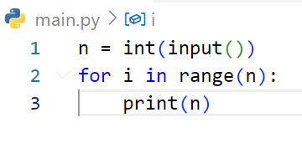
Write step following code below
step | n | i | output
1 | 3
2 | 3 | 0
3 | 3 | 0 | 3
4 | 3 | 1
5 | 3 | 1 | 3
6 | 3 | 2
7 | 3 | 2 | 3
# If user enter : 3

Slide 16
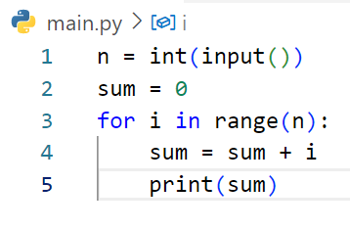
Write step following code below
Step | i | n | sum | output
1 |  | 3
2 |  | 3 | 0
3 | 0 | 3 | 0
4 | 0 | 3 | 0
5 | 0 | 3 | 0 | 0
6 | 1 | 3 | 0
7 | 1 | 3 | 1
8 | 1 | 3 | 1 | 1
9 | 2 | 3 | 1
10 | 2 | 3 | 2
# If user enter : 3
11
2
3
2
2

Slide 17
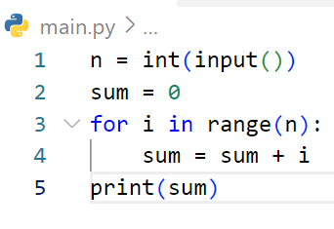
Write step following code below
Step | i | n | sum | output
1 |  | 2
2 |  | 2 | 0
3 |  | 2 | 0
4 | 0 | 2 | 0
5 | 0 | 2 | 0 | 0
6 | 1 | 2 | 1
7 | 1 | 2 | 1 | 1
# If user enter : 2

Slide 18
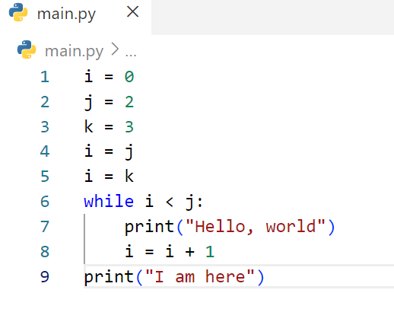
Write step following code below
Step | i | j | k | i<j
1 | 0
2 | 0 | 2
3 | 0 | 2 | 3
4 | 2 | 2 | 3
5 | 3 | 2 | 3
6 | 3 | 2 | 3 | False
7 | 3 | 2 | 3
output
I am here

Slide 19
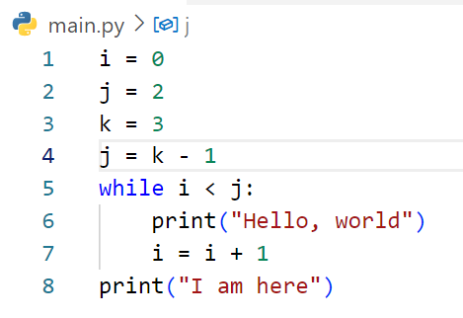
step | i | j | k | i<j | Output
1 | 0
2 | 0 | 2
3 | 0 | 2 | 3
4 | 0 | 2 | 3
5 | 0 | 2 | 3 | True
6 | 0 | 2 | 3 |  | Hello ,world
7 | 1 | 2 | 3
Write step following code below
8 | 1 | 2 | 3 | True
9 | 1 | 2 | 3 |  | Hello, world
10 | 2 | 2 | 3
11 | 2 | 2 | 3 | False
12 | 2 | 2 | 3 |  | Hello world Hello world I am here

Slide 20
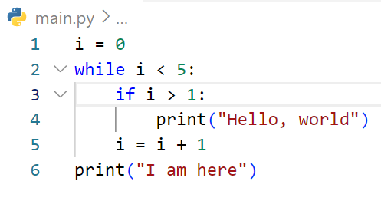
step | i | i<5 | i>1 | output
1 | 0
2 | 0 | True
3 | 0 |  | False
4 | 1 | True
5 | 1 |  | False
6 | 2
7 | 2 | True
Write step following code below
8 | 2 |  | True
9 | 2 |  |  | Hello world
10 | 3
11 | 3 | True
12 | 3 |  | True
12 | 3 |  |  | Hello world
14 | 4
15 | 4 | True
16 | 4 |  | True
17 | 4 |  |  | Hello world
18 | 5
19 | 5 | False
20 | 5 |  |  | Hello, world Hello, world Hello, world I am here

Slide 21
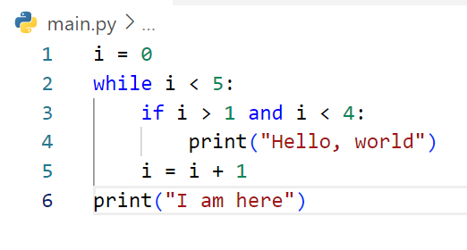
Write step following code below
Step | i | i<5 | i>0 and i<4 | Output
1 | 0
2 | 0 | True
3 | 0 |  | False
4 | 1
5 | 1 | True
6 | 1 |  | False
7 | 2
8 | 2 | True
9 | 2 |  | True
10 | 2 |  |  | Hello world
11 | 3
12 | 3 | True
13 | 3 |  | True
14 | 3 |  |  | Hello world
15 | 4
16 | 4 | True
17 | 4 |  | False
18 | 5
19 | 5 | False
20 | 5 |  |  | Hello world Hello world I am here

Slide 22
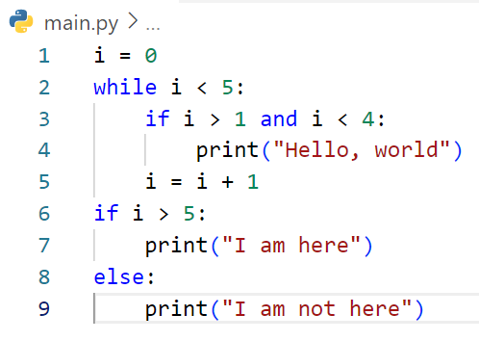
Step | i | i<5 | i>1 and i<4 | i>5 | output
1 | 0
2 | 0 | True
3 | 0 |  | False
4 | 1
5 | 1 | True
6 | 1 |  | False
7 | 2
8 | 2 | True
9 | 2 |  | True
10 | 2 |  |  |  | Hello world
Write step following code below
11 | 3
12 | 3 | True
13 | 3 |  | True
14 | 3 |  |  |  | Hello world
15 | 4
16 | 4 | True
17 | 4 |  | False
18 | 5
19 | 5 | False
20 | 5 |  |  | False
21 | 5 |  |  |  | I am not here

Slide 23
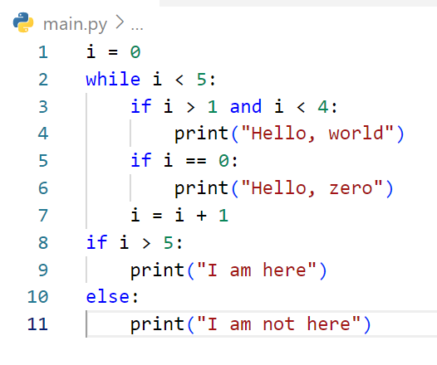
Step | i | result | i<5 | i>1 and i<4 | i==0 | i>5 | Output
1 | 0
2 | 0 | “”
3 | 0 | “” | True
4 | 0 | “” |  | False
5 | 0 | “” |  |  | True
6 | 0 | “” |  |  |  |  | Hello zero
7 | 1 | “”
8 | 1 | “” | True
9 | 1 | “” |  | False
10 | 1 | “” |  |  | False
Write step following code below
11 | 2 | “”
11 | 2 | “” | True
12 | 2 | “” |  | True
13 | 2 | “” |  |  |  |  | Hello world
14 | 2 | “” |  |  | False
15 | 3 | “”
16 | 3 | “” | True
17 | 3 | “” |  | True
18 | 3 | “” |  |  |  |  | Hello world
19 | 3 | “” |  |  | False
20 | 4 | “”
21 | 4 | “” | True
22 | 4 | “” |  | False
23 | 4 | “” |  |  | False
24 | 5 | “”
25 | 5 | “” | False
26 | 5 | “” |  |  |  | False
27 | 5 | “” |  |  |  |  | I am here

Slide 24
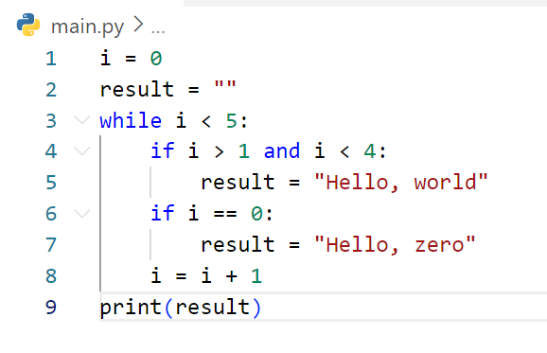
Step | i | result | i<5 | i>1 and i<4 | i==0 | output
1 | 0
2 | 0 | “”
3 | 0 | “” | True
4 | 0 | “” |  | False
5 | 0 | “” |  |  | True
6 | 0 | Hello zero
7 | 1 | “”
8 | 1 | “” | True
9 | 1 | “” |  | False
10 | 1 | “” |  |  | False
Write step following code below
11 | 2 | “”
12 | 2 | “” | True
13 | 2 | “” |  | True
14 | 2 | Hello world
15 | 2 | “” |  |  | False
16 | 3 | “”
17 | 3 | “” | True
18 | 3 | “” |  | True
19 | 3 | “”
20 | 3 | Hello world |  |  | False
21 | 4
22 | 4 |  | True
23 | 4 |  |  | False
24 | 4 |  |  |  | False
25 | 5 |  | False
26 | 5 | “” | False

Slide 25
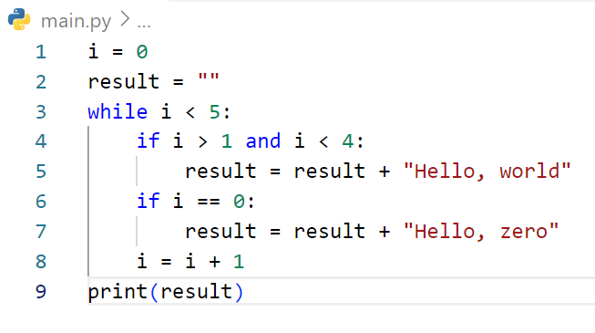
Step | i | i<5 | i>1 and i<4 | i==0 | Result
1 | 0
2 | 0 |  |  |  | “”
3 | 0 | True |  |  | “”
4 | 0 |  | False |  | “”
5 | 0 |  |  | True | “”
6 | 0 |  |  |  | Hello, zero
7 | 1
8 | 1 | True
9 | 1 |  | False
10 | 1 |  |  | False
Write step following code below
11 | 2
12 | 2 | True
13 | 2 |  | True
14 | 2 |  |  |  | Hello zero Hello world
15 | 2 |  |  | False
16 | 3
17 | 3 | True
18 | 3 |  | True
19 | 3 |  |  |  | Hello zero Hello world Hello world
20 | 3 |  |  | False
21 | 4
22 | 4 | True
23 | 4 |  | False
24 | 4 |  |  | False
25 | 5
26 | 5 | False
27 | 5 |  |  |  |  | Hello zero Hello world Hello world

Slide 26
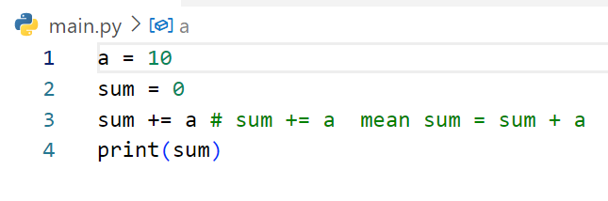
Write step following code below
Step | a | sum | output
1 | 10
2 | 10 | 0
3 | 10 | 10
4 | 10 | 10 | 10

Slide 27
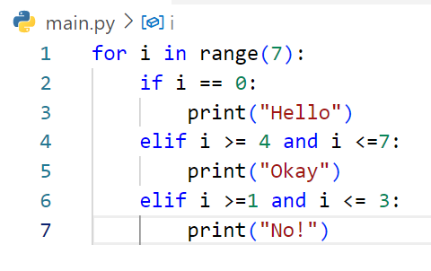
Step | i | i==0 | i>=4 and i<=7 | i>=1 and i<=3 | output
1 | 0
2 | 0 | True
3 | 0 |  |  |  | Hello
4 | 1
5 | 1 | False
6 | 1 |  | False
7 | 1 |  |  | True
8 | 1 |  |  |  | OKay
9 | 2
10 | 2 | False
Write step following code below
11 | 2 |  | False
12 | 2 |  |  | True
13 | 2 |  |  |  | Okay
14 | 3
15 | 3 | False
16 | 3 |  | False
17 | 3 |  |  | True
18 | 3 |  |  |  | OK
19 | 4
20 | 4 | False
10 | 2 |  | True

Slide 28
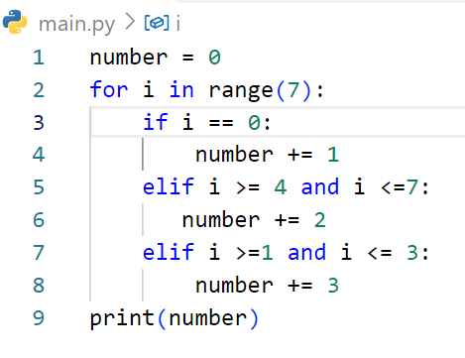
Step | i | number | i==0 | i>=4 and i<=7 | i>=1 and i<=3 | Output
1 |  | 0
2 | 0 | 0
3 | 0 | 0 | True
4 | 0 | 1
5 | 1 | 1
6 | 1 | 1 |  |  | True
7 | 1 | 4
8 | 2 | 4
9 | 2 | 4 |  |  | True
10 | 2 | 7
Write step following code below
11 | 3 | 7
12 | 3 | 7 |  |  | True
13 | 3 | 10
14 | 4 | 10
15 | 4 | 10 |  | True
16 | 4 | 12
17 | 5 | 12 |  | True
18 | 5 | 14
19 | 6 | 14
20 | 6 | 14 |  | True
21 | 6 | 16
22 | 6 | 16 |  |  |  | 16

